Slide 1
Sentiment Analysis (Using BERT)
Understanding Human Emotions Through Transformer-Based Deep Learning Models

Slide 2
Contents
01
02
03
Introduction & Importance
Traditional Approaches
Statistical ML Models
What sentiment analysis is and why it matters
Lexicon-based methods and their limitations
Machine learning for sentiment and its challenges
04
05
Transformers & BERT
Key Takeaways
Modern architecture, Python demo, and domain models
Industry insights and final synthesis

Slide 3
What is Sentiment Analysis?
Sentiment Analysis — also called Opinion Mining — is an NLP technique used to identify and classify emotions, opinions, and attitudes expressed in text. The goal: determine whether the sentiment is Positive, Negative, or Neutral.
Text
Sentiment
"The movie was fantastic."
✅ Positive
"The product quality is terrible."
❌ Negative
"The meeting was conducted yesterday."
➖ Neutral

Slide 4

Levels of Sentiment Analysis
Sentiment can be extracted at three granularity levels depending on the depth of analysis required.
1
2
3
Document-Level
Sentence-Level
Aspect-Level
Analyzes the overall sentiment of an entire document as a single unit.
Determines sentiment independently, sentence by sentence.
"The phone camera is excellent but battery life is poor" — Camera → Positive; Battery → Negative.

Slide 5

The Need for Sentiment Analysis
Organizations generate massive volumes of unstructured text daily — from social media and reviews to support tickets and surveys. Manual analysis is slow, costly, and unscalable.
Customer Feedback
Brand Monitoring
Automatically surface opinions at scale
Track public perception in real time
Market Intelligence
Automation
Understand competitors and customer needs
Reduce human effort in text classification
E-commerce giants like Amazon analyze millions of reviews daily to detect satisfaction, product defects, and service
quality issues.

Slide 6
Applications Across Industries
E-Commerce
Healthcare
Product review analysis, recommendation systems, satisfaction measurement
Patient feedback, mental health monitoring, public health sentiment tracking
Finance
Social Media
Stock market sentiment, financial news analysis, investor mood tracking
Political analysis, trend detection, public opinion monitoring
Customer Service
Education
Complaint detection, ticket prioritization, chatbot optimization
Student feedback, course evaluation, faculty performance assessment

Slide 7
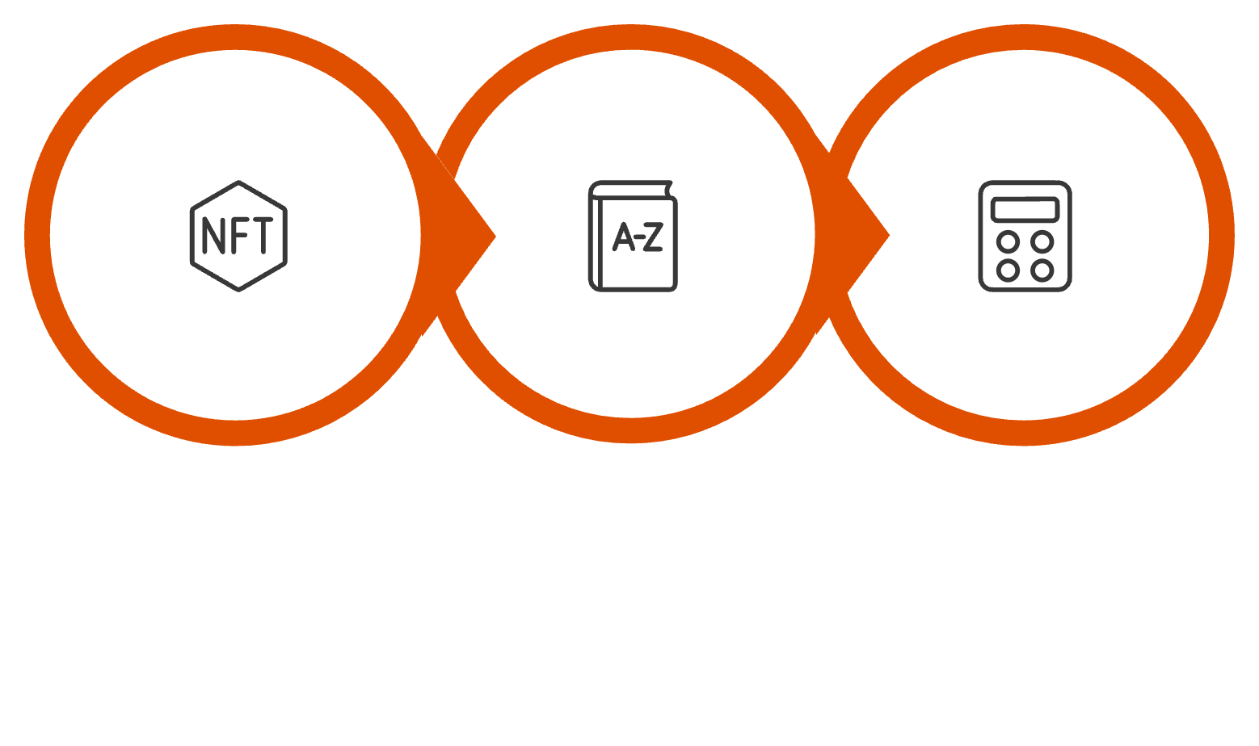

Traditional Approach: Lexicon-Based Sentiment Analysis
Lexicon-based methods use predefined sentiment dictionaries where each word carries a polarity score. The sentence score is computed by summing individual word scores.
Example Sentiment Lexicon
Word
Score
Excellent
+3
Good
+2
Bad
-2
Terrible
-3
Popular Lexicon Tools
VADER
TextBlob
SentiWordNet
AFINN
Tokenize
Match Words
Compute Score
Easy to implement · No training data needed · Fast execution

Slide 8
Limitations of Lexicon-Based Methods
Context Ignorance
Sarcasm Detection Failure
Negation Handling
"This movie is sick." — Slang is positive, but the lexicon flags it as negative.
"Great! Another software crash." — The actual sentiment is negative, but the word "Great" scores as positive.
"The product is not good." — Simple methods may incorrectly classify this as positive.
Domain Dependency
No Deep Semantics
"Unpredictable" is negative in automotive reviews but positive in movie reviews.
Lexicons cannot capture complex language relationships or true meaning.

Slide 9

Statistical ML Models for Sentiment Analysis
Instead of dictionaries, machine learning models learn sentiment patterns directly from labeled datasets, making them more adaptable and accurate.
Common Algorithms
Naive Bayes
Simple probabilistic classifier
Text Input
Logistic Regression
Feature Extraction
Effective for binary tasks
Model Training
SVM
Sentiment Output
High-dimensional text classification
Random Forest
Ensemble-based approach

Slide 10




Limitations of Statistical ML Models
Feature Engineering Dependency
Requires manual preprocessing and feature extraction — time-intensive and error-prone.
Poor Context Understanding
Cannot capture long-range dependencies in text. "Dog bites man" and "Man bites dog" may produce identical feature vectors.
Fixed Vocabulary & Data Hunger
Struggles with unseen words, and performance degrades significantly without large, high-quality labeled datasets.
These limitations make traditional ML models unsuitable for nuanced, real-world language understanding.

Slide 11
Transformer-Based Pretrained Models
Transformers revolutionized NLP by replacing sequential processing with self-attention mechanisms — enabling deep contextual understanding at scale.
Bidirectional Learning
Parallel Processing
Transfer Learning
Reads left and right context simultaneously
Faster training vs. RNNs and LSTMs
Fine-tune on specific tasks with minimal data
Popular Transformer Models
BERT
ROBERTA
DISTILBERT
XLNET
ALBERT
GPT

Slide 12
BERT
Bidirectional Encoder Representations from Transformers
Developed by Google, BERT reads text in both directions simultaneously, enabling rich contextual disambiguation. Given "I went to the bank," BERT infers whether "bank" means a financial institution or a river bank — based purely on surrounding words.
Contextual Understanding
State-of-the-Art Accuracy
Meaning derived from full sentence context
Top benchmark performance across NLP tasks
Minimal Feature Engineering
Semantic Interpretation
End-to-end learning from raw text
Captures complex language relationships

Slide 13

Python Demonstration Using BERT
Using the Hugging Face Transformers library, BERT-based sentiment analysis can be implemented in just a few lines of Python.
Step 1 — Install Required Libraries
pip install transformers torch
Step 2 — Run the Sentiment Pipeline
from transformers import pipeline
classifier = pipeline("sentiment-analysis")
result = classifier("The course content is excellent and very informative.")
print(result)
Expected Output
[{'label': 'POSITIVE', 'score': 0.9998}]
The pipeline automatically loads a pretrained BERT model and returns a label with a confidence score — no manual feature engineering required.

Slide 14

Domain-Specific Pretrained Models
General-purpose BERT may underperform in specialized fields. Domain-specific variants are fine-tuned on industry corpora for superior results.
FinBERT 📈
BioBERT 🏥
Finance — Financial news analysis, stock market sentiment prediction, investor mood tracking
Healthcare — Medical document analysis, clinical NLP, biomedical entity recognition
LegalBERT ⚖️
RoBERTa & DistilBERT 🚀
Legal — Legal document classification, case analysis, contract review
Optimized BERT variants — RoBERTa for accuracy; DistilBERT for lightweight, fast deployment
Domain-specific models understand specialized vocabulary, terminology, and language patterns that general models frequently misinterpret.

Slide 15
Key Takeaways & Industry Insights
Lexicon Methods
1
Fast and simple, but fail on context and sarcasm
2
Statistical ML
Data-driven patterns, limited by feature engineering
Transformers
3
Self-attention unlocks true contextual understanding
4
BERT & Variants
Bidirectional learning sets the state of the art
Domain Models
5
Specialized pretraining maximizes industry performance
Modern NLP systems powered by Transformer-based models are transforming how organizations understand human language and emotions at scale — across business intelligence, healthcare, finance, and beyond.

